Slide 1
Spring Boot Configuration

Slide 2
Why Spring Boot?
Relieves Programmer from multiple manual configurations – spring boot provides auto configurations
Lets programmer easily develop production ready applications, with minimal effort
It makes it easier to integrate the Spring Boot Application with the Spring that majorly includes Spring ORM, Spring JDBC, Spring Security, Spring Data and many other things.
Provides Dev tools(spring-boot-devtools), helpful in remote debugging
It tests the web applications easily with the help of different Embedded HTTP servers that includes Tomcat, Jetty and many others.
However Spring Boot carries all advantages of Spring as well.

Slide 3
Spring Boot First App
1. Create POM file: You can see that spring-boot-starter-parent provides no dependencies by itself. To add the necessary dependencies, edit your pom.xml and add the spring-boot-starter-web dependency immediately below the parent section:
2.Create class file and annotate with @SpringBootApplication
@SpringBootApplication annotation is equivalent to using @Configuration, @EnableAutoConfiguration and @ComponentScan with their default attributes:
3.Application.properties: this file is optional can be placed and under folder resources. Custom configurations are specified in this file
Develop any other functionality...say RestControllers or which ever

Slide 4
Spring Boot First App
Latest Spring Boot version is 2.x
<parent>
<groupId>org.springframework.boot</groupId>
<artifactId>spring-boot-starter-parent</artifactId> <version>1.5.2.RELEASE</version>
</parent>
<dependencies>
<dependency> <groupId>org.springframework.boot</groupId> <artifactId>spring-boot-starter</artifactId>
</dependency>
</dependencies>
Basic starter for Spring Boot App

Slide 5
Spring-boot-starter-parent
The spring-boot-starter-parent is the core starter that includes auto-configuration support, logging, and YAML. The application is packaged into a JAR file. It includes
Configuration - Java Version and Other Properties
Dependency Management - Version of dependencies

Slide 6
Spring Boot Starters
Starters are a set of convenient dependency descriptors which we can include in our application.
Spring Boot provides built-in starters which makes development easier and rapid.
For example, if we want to get started using Spring and JPA for database access, just include the spring-boot-starter-data-jpa dependency in your project.
Starter should follow a naming pattern like: spring-boot-starter-*, where * is a particular type of application.

Slide 7
@Component vs @Bean
@Component (and @Service and @Repository) are used to auto-detect and auto-configure beans using classpath scanning. There's an implicit one-to-one mapping between the annotated class and the bean (i.e. one bean per class). Control of wiring is quite limited with this approach, since it's purely declarative.
@Bean is used to explicitly declare a single bean, rather than letting Spring do it automatically as above. It decouples the declaration of the bean from the class definition, and lets you create and configure beans exactly how you choose.
Sometimes automatic configuration is not an option. When? Let's imagine that you want to wire components from 3rd-party libraries (you don't have the source code so you can't annotate its classes with @Component), so automatic configuration is not possible.
The @Bean annotation returns an object that spring should register as bean in application context. The body of the method bears the logic responsible for creating the instance.

Slide 8
@Component, @Repository, @Service and @Controller
@Component annotation marks a java class as a bean so the component-scanning mechanism of spring can pick it up and pull it into the application context.
@Repository annotation is a specialization of the @Component annotation with similar use and functionality. In addition to importing the DAOs into the DI container, it also makes the unchecked exceptions (thrown from DAO methods) eligible for translation into Spring DataAccessException.
@Service over @Component in service-layer classes because it specifies intent better. Additionally, tool support and additional behavior might rely on it in the future.
@Controller annotation marks a class as a Spring Web MVC controller. It too is a @Componentspecialization, so beans marked with it are automatically imported into the DI container. When you add the @Controller annotation to a class, you can use another annotation i.e. @RequestMapping; to map URLs to instance methods of a class.

Slide 9
Spring Bean Life Cycle - @PostConstruct and @PreDestroy
In Spring framework, we can manage lifecycle of a bean by using method-level annotations @PostConstruct and @PreDestroy.
The @PostConstruct annotation is used on a method that needs to be executed after dependency injection is done to perform any initialization.
The @PreDestroy annotation is used on methods as a callback notification to signal that the instance is in the process of being removed by the container.

Slide 10
Spring Boot First App
A simple Bean can also be created using @Bean.
Spring @Bean annotation tells that a method produces a bean to be managed by the Spring container. It is a method-level annotation. During Java configuration (@Configuration), the method is executed and its return value is registered as a bean within a BeanFactory.

Slide 11
Manual Configurations in Traditional Spring F/W
In Spring Framework, all Configurations need to be provided by the developer, for example consider implementation of Spring MVC, developer need to provide InternalResourceViewResolver
<bean
class="org.springframework.web.servlet.view.InternalResourceViewResolver">
<property name="prefix">
<value>/WEB-INF/views/</value>
</property>
<property name="suffix">
<value>.jsp</value>
</property>
</bean>
<mvc:resources mapping="/webjars/**" location="/webjars/"/>
Notes:
Internationalization, port number, urls, Heap size?? Db urls & credentials?? install subset of modules/features

Slide 12
Manual Configurations in Traditional Spring F/W
And when Hibernate is used, below configurations need to be provided
So, whats problem with this Manual Configurations,
Waste of Developer’s time
Error prone
And most of the configurations remain same…
Spring Boot has relieved us from this Brutal effort, by providing Auto Configurations
Notes:
Internationalization, port number, urls, Heap size?? Db urls & credentials?? install subset of modules/features

Slide 13
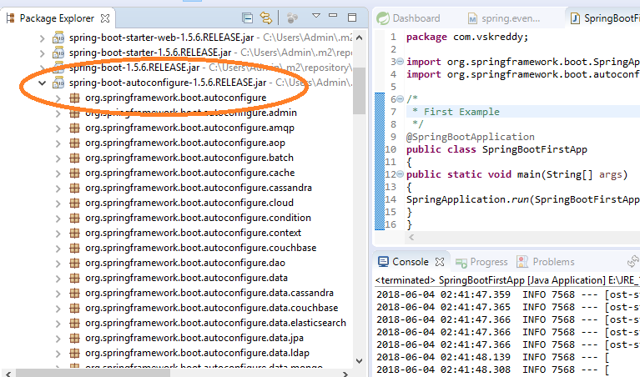
Spring Boot Auto Configuration
Spring Boot looks at
Frameworks available on the CLASSPATH
Existing configuration for the application.
Based on these, Spring Boot provides basic configuration needed to configure the application with these frameworks.
This is called Auto Configuration.
Notes:
Internationalization, port number, urls, Heap size?? Db urls & credentials?? install subset of modules/features

Slide 14
Spring Boot Configuration
Though Spring Boot Auto configures, developer can provide additional configurations, which are External Configurations.
Configuration properties can be provided in two different ways
Auto or internal Configuration
External Configuration
Auto Configuration are the ones, which are implicitly provided by Spring Boot, whenever a dependency artifact id is specified in pom.xml, Spring Framework implicitly invokes XyzAutoConfiguration, where Xyz is name of Artifact ID.
What is the need for Configurations in a Project? Any realtime examples?
Observe Effective POM?
Create a simple Controller using Spring Boot…
Notes:
Internationalization, port number, urls, Heap size?? Db urls & credentials?? install subset of modules/features

Slide 15
Spring Component Annotations
@Component, @Service, and @Controller. @Component is a generic stereotype for any Spring-managed component.
@Repository, @Service, and @Controller are specializations of @Component for more specific use cases, for example, in the persistence, service, and presentation layers, respectively.
Therefore, you can annotate your component classes with @Component, but by annotating them with @Repository, @Service, or @Controller instead, your classes are more properly suited for processing by tools or associating with aspects. For example, these stereotype annotations make ideal targets for pointcuts.
Thus, if you are choosing between using @Component or @Service for your service layer, @Service is clearly the better choice.
Notes:
Internationalization, port number, urls, Heap size?? Db urls & credentials??

Slide 16
Spring Boot External Configuration
It is a standard practice that during our production deployments, our application loads property files from external locations.
This helps us to change our configurations without changing our code. Let us see how to load external property files into Spring Boot application.
By default, Spring Boot look for externalized default property file application.properties into given below predetermined locations:
-- In the classpath root.
-- In the package "/config" in classpath.
-- In the current directory.
-- In the "/config" directory of current folder.
Now lets say, your application requires externalized properties like application.properties and another property file myapp.properties. The both properties can be in the same folder or they can be in different folder.
There are 3 ways of doing it.

Slide 17
Spring Boot External Configuration
Command Line arguments
java -jar myapp.jar --spring.config.name=application,myapp
--spring.config.location=classpath:/data/myapp/config,classpath:/data/myapp/external/config
In above command, property file name is passed thru "--spring.config.name" variable and folder location thru "--spring.config.location" variable.
-Dspring.config.location="C:\\spring_boot_training\\abcd.properties"

Slide 18
Spring Boot External Configuration
Environment Variables
set SPRING_CONFIG_NAME=application,myapp
Set SPRING_CONFIG_LOCATION=classpath:/data/myapp/config,classpath:/data/myapp/external/config
java -jar myapp.jar

Slide 19
Spring Boot External Configuration
Programmatically Load Configurations
ConfigurableApplicationContext applicationContext = new SpringApplicationBuilder(SpringBootWebApplication.class)
.properties("spring.config.name:application,myapp",
"spring.config.location:classpath:/data/myapp/config,classpath:/data/myapp/external/config")
.build().run(args);

Slide 20
@Configuration Properties in Spring Boot
In Spring Boot, the @ConfigurationProperties annotation allows us to map the resource files such as properties or YAML files to Java Bean object.
This annotation is applied to a class or a @Bean method in a @Configuration class to map or validate the external properties or YAML files.
@EnableConfigurationProperties

Slide 21
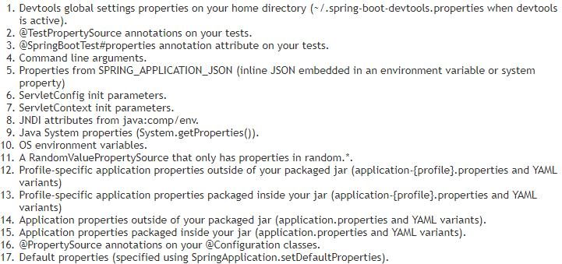
Spring Boot Property Configuration order - External Configurations

Slide 22
Spring Boot Profiles - External Configurations
A profile is a set of settings that can be configured to override settings from application.properties.
Each profile is contained in a file named application-profilename.properties where profilename is the name of the profile.
Now, a profile could configure anything you want, however for most projects it is proposed to have the following profiles:
dev for your local development settings
staging for your staging server settings
prod for your production settings
test for running your tests
Whether you have all above environment in your application or not, you must have a dev, a prod and a test profile. The configuration for these environments needs to be different for obvious reasons.

Slide 23
Spring Boot Profiles
How to Set an Active profile?
Once you have profile specific configuration, you would need to set the active profile in an environment.
There are multiple ways of doing this
Using -Dspring.profiles.active=prod in VM Arguments
Use spring.profiles.active=prod in application.properties
Lets set it in application.properties by add another property to application.properties
spring.profiles.active=dev

Slide 24
Spring Boot Profiles
Profiles may not be only limited to dev, qa, prod etc…. Depending on nature of product there can be multiple production deployments it self based on the load it expects…Demo, small, medium, big, for example consider AppDynamics Software
http://start.spring.io/
@value Annotation
https://www.javacodegeeks.com/2018/02/create-spring-boot-project-spring-initializer.html

Slide 25
Packaging Spring Boot Application
Spring Boot has simplified the deployment of Java-based web/API applications drastically. It has eliminated the process of deploying a WAR file into the web container provided by Tomcat or any other application servers.
It has brought in a new paradigm shift where the container libraries (like Tomcat/Ubuntu/Jetty) are themselves embedded along with application classes/JAR within the fat Spring Boot JAR — thus making it a truly standalone application and a candidate for microservice development.
This saves Server setup time, into production, you just have only jar file which need to be deployed.
But, there are few minor challenges, which a spring boot developer would face, when deploying the Spring boot application.

Slide 26
Packaging Spring Boot Application
How do we ship the external configuration files like application.properties, configuration XML files, etc. along with the Spring Boot JAR?
How can we copy the start-up script with VMs and other parameters to start the application to deployment environments?
Should we manually create log directories in the new environment and make the changes in the log4j.xml/log4j.properties of the application to point to the log directory?

Slide 27
Packaging Spring Boot Application
All the above would need manual configuration changes. Once we address the above concerns, the following questions would be addressed, automatically
Deploying the application to DEV/SIT/UAT/PROD environments via Continuous Integration/Continuous Deployment (CI/CD) infrastructure like Jenkins without any additional configuration in the deployment nodes.
Ship microservices with external configurations or dependencies, packed into one deployable artifact to any new developer, who can just run it by using a startup script.

Slide 28
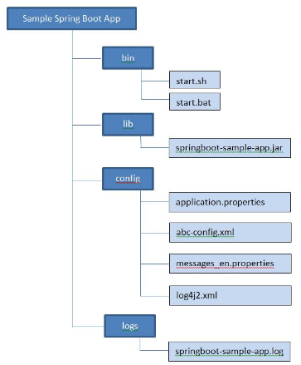
Packaging Spring Boot Application
Maven has the ability to bundle all the artifacts into a directory and create a .zip or a .tar file for easy shipment using the maven-assembly-plugin. We will have to leverage this feature to programmatically organize the dependent artifacts to support the Spring Boot JAR to run seamlessly.

Slide 29
Packaging Spring Boot Application
Step 3: Add Configuration Files to the Project
We will add additional configuration files and modify code to demonstrate the usage of configuration files and later externalize them from the gs-spring-boot project.
a) Add common configuration files under src/main/resources
i) application.properties [redefine server ports and other configurations].
ii) log4j2.xml [logging configurations].
iii) messages_en.properties [greetings message of the sample application externalized].

Slide 30
Packaging Spring Boot Application
b) Add environment specific configurations. E.g. Database connection details. Create an env directory under src/main/resources. Create the directories dev, qa, uat, and prod inside env. Place environment-specific files in each of the directories. In our example, it's env-config.properties, this has database connection pool details.
Setting the environment specific file in startup script will be illustrated, later.

Slide 31
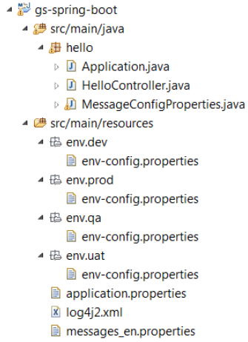
Packaging Spring Boot Application
c) Configuration file contents
i) application.properties
ii) messages_en.properties
iii) log4j2.xml
iv) env-config.properties and some more
Step 4: Modify the Code to Leverage Externalized Configuration Properties

Slide 32
Packaging Spring Boot Application
Step 5: Create Startup scripts, for Windows, Linux/Mac platforms
Create a directory bin under src/main/resources and add the startup scripts.
a) start.bat
b) start.sh
Step 6: Package the Application Using the Maven-Assembly-Plugin
a) Create the distribution, assembly file.
Create a distribution directory under src/main/resources. Place the assembly xml, gs-spring-boot- distribution.xml in it.
Step 6: The gs-spring-boot-distribution.xml has the instructions to assemble the Application by creating dependent directories (config, lib, bin and logs) and copying respective files into them. It finally creates a tar and a zip file for distribution.
b) Modify pom.xml to configure the assembly plugin.

Slide 33
Packaging Spring Boot Application
Step 7: Build the Maven Project
Build the Maven project and you will see the distributions files (gs-spring-boot-distribution.tar and gs-spring-boot-distribution.zip) under target directory. The following image shows the extracted ZIP/TAR file
Step 8: Running the Application
Developers can run the self-contained application by performing three simple steps in any environment.
1) Copy the TAR/ZIP file to the deployable node instance (DEV/SIT/UAT/PROD).
2) Untar the TAR file by issuing the following command.
tar –xvf gs-spring-boot-distribution.tar
For windows, unzip the gs-spring-boot-distribution.zip file
3) Go to the bin directory and invoke the start.sh file to run the application, bypassing the right environment as command line parameter.
The above steps can be automated through CI (Jenkins/Hudson).

Slide 34
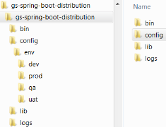
Packaging Spring Boot Application
Side note: All the external configuration files will be packaged in the JAR file, too. But the configuration files in the externalized config directory are always considered by the ClassLoader as they are passed as the system parameter in the startup script, using the system parameter,
-Dspring.config.location.
On the downside, you will not be able to run the application from Eclipse, just by running “Application.java” because the configuration files will not be copied to the target/classesdirectory. However, exclusion of files can be ignored.

Slide 35
Spring Boot – Create War
Until now for webapp jar was created, which had embedded web server. However in few cases we may want to use Spring Boot, and still deploy onto an external Web Server, this is possible by following below Steps
For Spring Boot WAR deployment to external Tomcat, you need to do below 4 steps:
#1. extend Bootmain app from SpringBootServletInitializer
@SpringBootApplication
public class SpringBootWebApplication extends SpringBootServletInitializer {
#2. Marked the embedded servlet container as provided in pom.xml (Provided means that you need the JAR for compiling, but at run time there is already a JAR provided by the environment so you don't need it packaged with your app.)
#3. Update packaging to war in pom.xml

Slide 36
Spring Boot – Create War
#1. Project(spring-boot-web-jsp.zip) uploaded to Misc folder in below location:
https://drive.google.com/open?id=14kf_bn6gZ8r1-Y5EAksDn-EsU_Y1ZdxQ
#2. Download & import above project to Spring Tool Suite IDE
#3. Download Apache Tomcat:
#4. From STS Run as on Server(Configrue Apache Tomcat).
(You may also manually package to war using maven command, and can manually deploy to tomcat)

Slide 37
Spring Boot Security
Spring security is the highly customizable authentication and access-control framework. Spring Security is a framework that focuses on providing both authentication and authorization to Java applications.
“Authentication” is the process of establishing a principal is who they claim to be (a “principal” generally means a user, device or some other system which can perform an action in your application).
“Authorization” refers to the process of deciding whether a principal is allowed to perform an action within your application. To arrive at the point where an authorization decision is needed, the identity of the principal has already been established by the authentication process.

Slide 38
Spring Security Modules
Spring Security 3.0, the codebase has been sub-divided into separate jars which more clearly separate different functionality areas and third-party dependencies.
Core (spring-security-core.jar) – APIs for basic authentication and access-control related mechanism. This is mandatory for ant spring security applications.
Web (spring-security-web.jar) – APIs for servlet filters and any web based authentication like access restriction for URLs. Any web application would require this module.
Config (spring-security-config.jar) – Contains the security namespace parsing code & Java configuration code. You need it if you are using the Spring Security XML namespace for configuration. If you are not using XML configurations, you can ignore this module.

Slide 39
Spring Security Modules
LDAP (spring-security-ldap.jar)– Required if you need to use LDAP authentication or manage LDAP user entries.
ACL (spring-security-acl.jar) – Specialized domain object ACL implementation. Used to apply security to specific domain object instances within your application.
CAS (spring-security-cas.jar) – Spring Security’s CAS client integration. If you want to use Spring Security web authentication with a CAS single sign-on server.
OpenID (pring-security-openid.jar) – OpenID web authentication support. Used to authenticate users against an external OpenID server.
Test (spring-security-test.jar)– Support for testing with Spring Security.

Slide 40
Spring Security Core Components
LDAP (spring-security-ldap.jar)– Required if you need to use LDAP authentication or manage LDAP user entries.
ACL (spring-security-acl.jar) – Specialized domain object ACL implementation. Used to apply security to specific domain object instances within your application.
CAS (spring-security-cas.jar) – Spring Security’s CAS client integration. If you want to use Spring Security web authentication with a CAS single sign-on server.
OpenID (pring-security-openid.jar) – OpenID web authentication support. Used to authenticate users against an external OpenID server.
Test (spring-security-test.jar)– Support for testing with Spring Security.

Slide 41
Spring Security pom.xml
<dependencies>
<!-- ... other dependency elements ... --> <dependency> <groupId>org.springframework.security</groupId>
<artifactId>spring-security-web</artifactId> <version>4.0.2.RELEASE</version>
</dependency>
<dependency>
<groupId>org.springframework.security</groupId>
<artifactId>spring-security-config</artifactId> <version>4.0.2.RELEASE</version>
</dependency>
</dependencies>

Slide 42
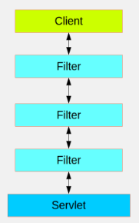
Security Filter & Filter Chains
Spring Security in the web tier (for UIs and HTTP back ends) is based on Servlet Filters. The picture below shows the typical layering of the handlers for a single HTTP request.
The client sends a request to the app, and the container decides which filters and which servlet apply to it based on the path of the request URI. At most one servlet can handle a single request, but filters form a chain, so they are ordered, and in fact a filter can veto the rest of the chain if it wants to handle the request itself. A filter can also modify the request and/or the response used in the downstream filters and servlet. The order of the filter chain is very important, and Spring Boot manages it through 2 mechanisms: one is that @Beans of type Filter can have an @Order or implement Ordered, and the other is that they can be part of a FilterRegistrationBean that itself has an order as part of its API.

Slide 43
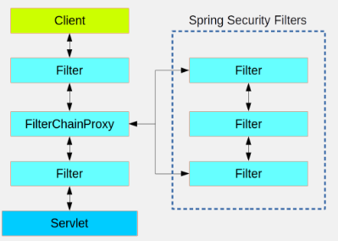
Security Filter & Filter Chains
Spring Security is installed as a single Filter in the chain, and its concerete type is FilterChainProxy, for reasons that will become apparent soon. In a Spring Boot app the security filter is a @Bean in the ApplicationContext

Slide 44
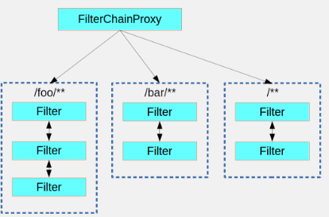
Security Filter & Filter Chains
There can be multiple filter chains all managed by Spring Security in the same top level FilterChainProxy and all unknown to the container. The Spring Security filter contains a list of filter chains, and dispatches a request to the first chain that matches it. The picture below shows the dispatch happening based on matching the request path (/foo/** matches before /**).

Slide 45
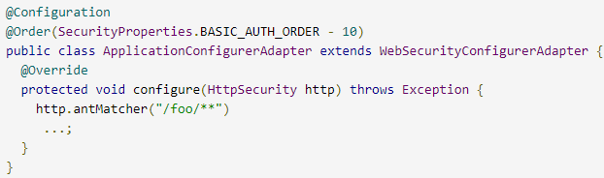
Creating & Customizing Filter Chains
The default fallback filter chain in a Spring Boot app (the one with the /** request matcher) has a predefined order of SecurityProperties.BASIC_AUTH_ORDER. You can switch it off completely by setting security.basic.enabled=false, or you can use it as a fallback and just define other rules with a lower order. To do that just add a @Bean of type WebSecurityConfigurerAdapter (or WebSecurityConfigurer) and decorate the class with @Order

Slide 46
Spring Security Basic Configuration
Basic example of a Spring Security Java configuration:
@EnableWebSecurity
public class SecurityConfig extends WebSecurityConfigurerAdapter {
@Autowired
public void configureGlobal(AuthenticationManagerBuilder auth)
throws Exception {
auth.inMemoryAuthentication() .withUser("user").password("password").roles("USER")
.and()
.withUser("admin").password("password").roles("USER", "ADMIN");
}
}
Above configuration sets up a basic in-memory authentication config.
TBD: Which all methods exist in WebSecurityConfigurerAdapter class

Slide 47
Http Security
To enable HTTP Security in Spring, we need to extend the WebSecurityConfigurerAdapter to provide a default configuration in the configure(HttpSecurity http) method:
protected void configure(HttpSecurity http) throws Exception {
http.authorizeRequests()
.anyRequest().authenticated()
.and().httpBasic();
}
https://docs.spring.io/spring-security/site/docs/4.2.4.RELEASE/apidocs/org/springframework/security/config/annotation/web/builders/HttpSecurity.html
The above default configuration makes sure any request to the application is authenticated with form based login or HTTP basic authentication. Also, it is exactly similar to the following XML configuration:
<http>
<intercept-url pattern="/**" access="authenticated"/>
<form-login />
<http-basic />
</http>

Slide 48
Form Login
Spring Security generates a login page automatically, based on the features that are enabled and using standard values for the URL which processes the submitted login:
protected void configure(HttpSecurity http) throws Exception {
http.authorizeRequests()
.anyRequest().authenticated()
.and().formLogin()
.loginPage("/login").permitAll();
}
Above automatically generated login page is convenient to get up and running quickly.
usernameParameter(), passwordParameter()
TBD: How to use customized login page

Slide 49
LDAP Authentication
LDAP authentication is one of the widely used approach in enterprise grade applications. LDAP is used as central repository for user information and applications will connect to this repository for user searches and authentication.
Pom.xml snippet
<dependency>
<groupId>org.springframework.ldap</groupId>
<artifactId>spring-ldap-core</artifactId>
</dependency>
<dependency>
<groupId>org.springframework.security</groupId>
<artifactId>spring-security-ldap</artifactId>
</dependency>

Slide 50
OAuth2 Authentication
OAuth2.0 is an open authorization protocol, which allows accessing the resources of the resource owner by enabling the client applications on HTTP services such as Facebook, GitHub, etc. It allows sharing of resources stored on one site to another site without using their credentials. It uses username and password tokens instead.
OAuth 2.0 is a simple protocol that allows to access resources of the user without sharing passwords.
It provides user agent flows for running clients application using a scripting language, such as JavaScript. Typically, a browser is a user agent.
It accesses the data using tokens instead of using their credentials and stores data in online file system of the user such as Google Docs or Dropbox account.

Slide 51
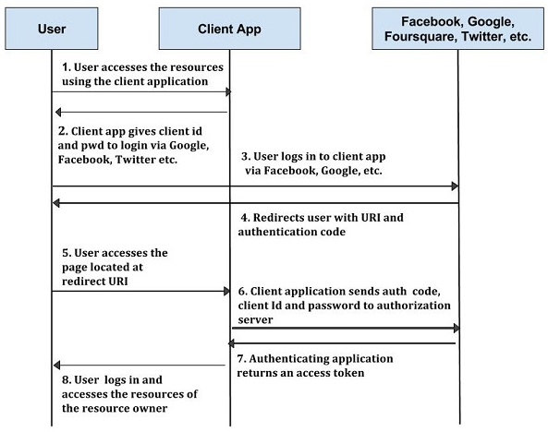
OAuth2 Architecture

Slide 52
Authorization
Lets configure some simple authorization on each URL using roles:
protected void configure(HttpSecurity http) throws Exception {
http.authorizeRequests()
.antMatchers("/", "/home").access("hasRole('USER')")
.antMatchers("/admin/**").hasRole("ADMIN")
.and()
// some more method calls
.formLogin();
}
hasRole() – but also the expression based API, via access.

Slide 53
Logout
As many other aspects of Spring Security, logout has some great defaults provided by the framework.
By default, a logout request invalidates the session, clears any authentication caches, clears the SecurityContextHolder and redirects to login page.
Here is a simple logout config:
protected void configure(HttpSecurity http) throws Exception {
http.logout();
}
However, if you want to get more control over the available handlers, here’s what a more complete implementation will look like:
protected void configure(HttpSecurity http) throws Exception {
http.logout().logoutUrl("/my/logout")
.logoutSuccessUrl("/my/index")
.logoutSuccessHandler(logoutSuccessHandler)
.invalidateHttpSession(true)
.addLogoutHandler(logoutHandler)
.deleteCookies(cookieNamesToClear)
.and()
// some other method calls
}

Slide 54
Logout
As many other aspects of Spring Security, logout has some great defaults provided by the framework.
By default, a logout request invalidates the session, clears any authentication caches, clears the SecurityContextHolder and redirects to login page.
Here is a simple logout config:
protected void configure(HttpSecurity http) throws Exception {
http.logout();
}
However, if you want to get more control over the available handlers, here’s what a more complete implementation will look like:
protected void configure(HttpSecurity http) throws Exception {
http.logout().logoutUrl("/my/logout")
.logoutSuccessUrl("/my/index")
.logoutSuccessHandler(logoutSuccessHandler)
.invalidateHttpSession(true)
.addLogoutHandler(logoutHandler)
.deleteCookies(cookieNamesToClear)
.and()
// some other method calls
}

Slide 55
JDBC Authentication
To move that to JDBC, all you have to do is to define a data source within the application – and use that directly: //TBD
@Autowired
private DataSource dataSource;
@Autowired
public void configureGlobal(AuthenticationManagerBuilder auth)
throws Exception {
auth.jdbcAuthentication().dataSource(dataSource)
.withDefaultSchema()
.withUser("user").password("password").roles("USER")
.and()
.withUser("admin").password("password").roles("USER", "ADMIN");
}

Slide 56

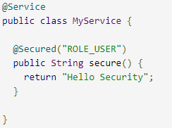
Creating & Customizing Filter Chains
Spring Security offers support for applying access rules to Java method executions. The first step is to enable method security, for example in the top level configuration for our app:
Then we can decorate the method resources directly, as shown beside
This sample is a service with a secure method. If Spring creates a @Bean of this type then it will be proxied and callers will have to go through a security interceptor before the method is actually executed. If the access is denied the caller will get an AccessDeniedException instead of the actual method result.
There are other annotations that can be used on methods to enforce security constraints, notably @PreAuthorize and @PostAuthorize, which allow you to write expressions containing references to method parameters and return values respectively.

Slide 57
CORS
Lets configure some simple authorization on each URL using roles:
protected void configure(HttpSecurity http) throws Exception {
http.authorizeRequests()
.antMatchers("/", "/home").access("hasRole('USER')")
.antMatchers("/admin/**").hasRole("ADMIN")
Exceptions

Slide 58
How to disable Security?
Add below lines to application.properties :
security.basic.enabled=false
management.security.enabled=false

Slide 59
Spring JMS
JMS (Java Message Service) is a Java Message Oriented Middleware used to send messages between clients and works by sending messages to a message queue which are then taken when possible to execute a transaction. This post will focus on implementing JMS with Spring Boot, which doesn’t take long at all to setup.
JMS and message queues, in general, bring some certain advantages over using RESTful services such as:
Loose coupling: The services do not interact directly and only know where the message queue is, where one service sends messages(Publisher) and the other(Subscribers) receives them. Subscribers/Publishers can be added/removed dynamically.

Slide 60
Spring JMS
Asynchronous messaging: As the process time of the message cannot be guaranteed, the client that sent the message can carry on asynchronously to the completion of the transaction. Due to this, the queue should be used to write data (POST if you're thinking in a RESTful mindset).
Redundancy: A message must confirm that it has completed its transaction and that it can now be removed from the queue, but if the transaction fails it can be reprocessed. The messages can also be stored in a database allowing them to continue later on even if the server stops.

Slide 61
Spring JMS
Pom.xml Dependencies
<dependency>
<groupId>org.springframework.boot</groupId>
<artifactId>spring-boot-starter-activemq</artifactId>
</dependency>
<dependency>
<groupId>com.fasterxml.jackson.core</groupId>
<artifactId>jackson-databind</artifactId>
</dependency>
dependency>
<groupId>org.json</groupId>
<artifactId>json</artifactId>
</dependency>
Publisher
//Get JMS template bean reference
JmsTemplate jmsTemplate = context.getBean(JmsTemplate.class);
// Send a message
System.out.println("Sending a message.");
jmsTemplate.convertAndSend("jms.message.endpoint", new Message(1001L, "test body", new Date()));

Slide 62
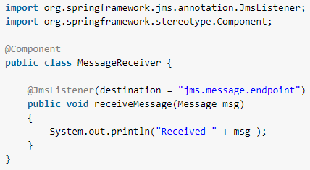
Spring JMS
Subscriber: JMS Message Receiver with @JmsListener
Message receiver class ispretty much simple class with single method with annotation @JmsListener. @JmsListener allows you to expose a method of a managed bean as a JMS listener endpoint.
So whenever any message is available on configured queue (in this example queue name is “jms.message.endpoint”), annotated method (i.e. receiveMessage) will be invoked.

Slide 63
Spring JMS
application.properties file
jsa.activemq.broker.url=tcp://localhost:61616
jsa.activemq.borker.username=admin
jsa.activemq.borker.password=admin
jsa.activemq.topic=jsa-topic

Slide 64
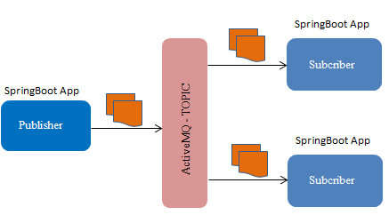
Spring Boot JMS
ActiveMq provides the Publish-Subscribe pattern (pub-sub) for building Jms message distributed systems. How it work? -> When you publish a messages, all active subscribers will receive a copy of the message.
Home page of ActiveMQ - http://activemq.apache.org/
Any Language/Platform
Any Language/Platform

Slide 65
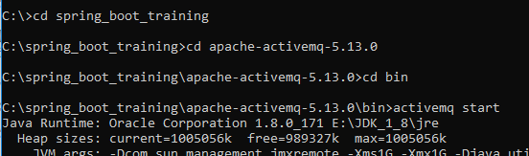

Spring Boot JMS
Download and install ActiveMQ from URL http://activemq.apache.org/activemq-5130-release.html
After downloading ActiveMQ, you can start ActiveMQ, as below
Once ActiveMQ is started successfully, open the ActiveMQ Admin URL http://localhost:8161/admin/
You can access Subscribers from its tab

Slide 66
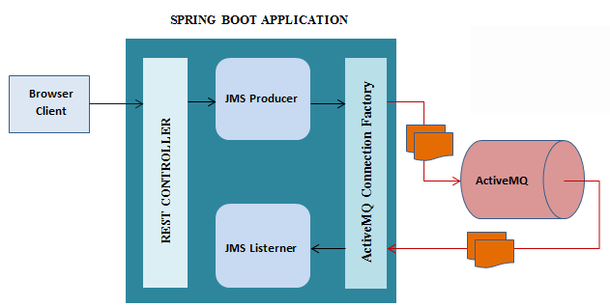
ActiveMQ with REST

Slide 67
ActiveMQ
RabbitMQ, Kafka, and ActiveMQ are all messaging technologies used to provide asynchronous communication and decouple processes (detaching the sender and receiver of a message). They are called message queues, message brokers, or messaging tools. RabbitMQ, Kafka, and ActiveMQ all serve the same basic purpose, but can go about their jobs differently. Kafka is a high-throughput distributed messaging system. RabbitMQ is an AMQP based reliable message broker. ActiveMQ and Kafka are both Apache products, and both written in Java; RabbitMQ is written in Erlang.
Apache ActiveMQ is fast, supports many Cross Language Clients and Protocols, comes with easy to use Enterprise Integration Patterns and many advanced features while fully supporting JMS 1.1 and J2EE 1.4. Apache ActiveMQ is released under the Apache 2.0 License.
Kafka is a distributed, partitioned, replicated commit log service. It provides the functionality of a messaging system, but with a unique design.

Slide 68
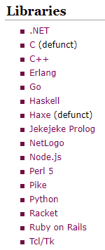
ActiveMQ – Cross Language Clients
Apache ActiveMQ is a message broker written in Java with JMS, REST and WebSocket interfaces, however it supports protocols like AMQP, MQTT, OpenWire and STOMP that can be used by applications in different languages.
Examples on how to use Publishers/Subscribers of different Languages:
http://activemq.apache.org/cross-language-clients.html

Slide 69
Characteristics of Topic
A JMS topic is the type of destination in a 1-to-many model of distribution.
The same published message is received by all consuming subscribers.
You can also call this the 'broadcast' model.
You can think of a topic as the equivalent of a Subject in an Observer design pattern for distributed computing.
Some JMS providers efficiently choose to implement this as UDP instead of TCP.
For topic's the message delivery is 'fire-and-forget' - if no one listens, the message just disappears.
If that's not what you want, you can use 'durable subscriptions'.

Slide 70
Characteristics of Queue
A JMS queue is a 1-to-1 destination of messages.
The message is received by only one of the consuming receivers (please note: consistently using subscribers for 'topic client's and receivers for queue client's avoids confusion).
Messages sent to a queue are stored on disk or memory until someone picks it up or it expires.
So queues (and durable subscriptions) need some active storage management, you need to think about slow consumers.
In most environments, topics are the better choice because you can always add additional components without having to change the architecture. Added components could be monitoring, logging, analytics, etc.

Slide 71
Other Middleware Messaging Solutions
RabbitMQ, Kafka, and ActiveMQ are all messaging technologies used to provide asynchronous communication and decouple processes (detaching the sender and receiver of a message). They are called message queues, message brokers, or messaging tools. RabbitMQ, Kafka, and ActiveMQ all serve the same basic purpose, but can go about their jobs differently. Kafka is a high-throughput distributed messaging system. RabbitMQ is an AMQP based reliable message broker. ActiveMQ and Kafka are both Apache products, and both written in Java; RabbitMQ is written in Erlang.
Apache ActiveMQ is fast, supports many Cross Language Clients and Protocols, comes with easy to use Enterprise Integration Patterns and many advanced features while fully supporting JMS 1.1 and J2EE 1.4. Apache ActiveMQ is released under the Apache 2.0 License.
Kafka is a distributed, partitioned, replicated commit log service. It provides the functionality of a messaging system, but with a unique design.

Slide 72
Spring Common App Properties
https://docs.spring.io/spring-boot/docs/current/reference/html/common-application-properties.html
Spring boot common app properties
https://docs.spring.io/spring-boot/docs/1.1.6.RELEASE/reference/html/common-application-properties.html

Slide 73
Spring Boot REST Web

